Slide 1

Introduction to R Programming

Slide 2
R
R – Basic installable file to support
R- Studio – IDE
R-Server

Slide 3
How R is developed
C
Fotran
R

Slide 4
Data structures in R
Vector – ordered collection of a similar data values
List – ordered collection of different types of data values
– no columns and Rows
Matrix – All columns should have same type of variables
– has columns and rows
Array – Similar to matrix but can have different type of variables
Data frame – A table that is composed of several vectors of the same length
– Object that is suitable to hold a dataset

Slide 5
Datatypes in R
Integer
Numeric
strings
Character
Factor
Date
Boolean
Character is a single letter, punctuation
String is a set of characters

Slide 6
Nomenclature of variables in R
All variable names must begin with a letter of the alphabet or an. underscore( _ )
Should not start with a number
Uppercase characters are distinct from lowercase characters.
Variable name cannot start with a number
No spaces are allowed in variable name
Variable name can be filled with characters like “_”, “.”

Slide 7
Exploratory data analytics in R
Issues with the Real-World Data
Missing values
Outliers
Erroneous data. Example: Num of dependents = -3
Few fields are sometimes constant – add no value to analysis
Data is insufficient - vital variables required for analysis may not be present
Solution/Fix for the issues
Perform EDA

Slide 8
Steps in EDA
Data Exploration:
Understand data structure
Analyse each variable
Observe the datatype of each variable
Identify the missing values
Check how big is the data
Data Validation:
Are all values correct?
Are there any outliers?
Are the missing values fixed?
Are the variables datatypes correct?

Slide 9
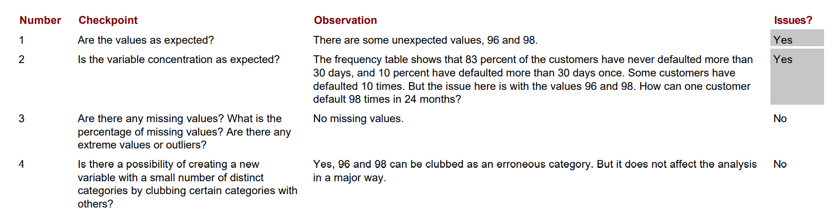
Missing values and outlier treatment

Slide 10
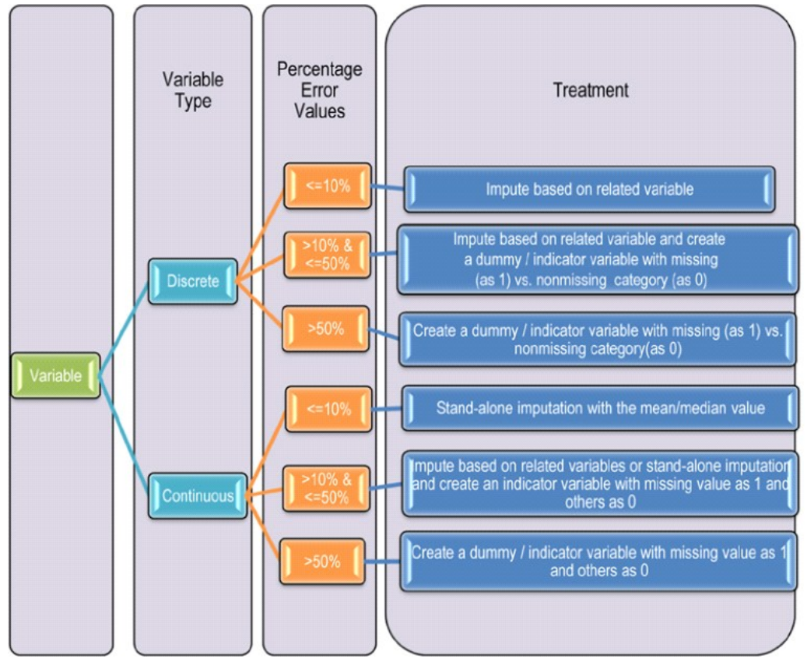
Missing values and outlier treatment

